Slide 1
Jupyter features and extensions

Slide 2
Keyboard Shortcuts
Help > Keyboard Shortcuts, or by pressing H in command mode
Cmd + Shift + P
The command palette.
Esc , Enter
While in command mode:
A to insert a new cell above the current cell, B to insert a new cell below.
M to change the current cell to Markdown, Y to change it back to code
D + D (press the key twice) to delete the current cell
Shift + Tab Docstring
Ctrl + Shift + - will split the current cell into two from where your cursor is.
Esc + F Find and replace on your code but not the outputs.
Esc + O Toggle cell output.
Select Multiple Cells:
Shift + J or Shift + Down selects the next sell in a downwards direction. You can also select sells in an upwards direction by using Shift + K or Shift + Up.
Once cells are selected, you can then delete / copy / cut / paste / run them as a batch. This is helpful when you need to move parts of a notebook.
You can also use Shift + M to merge multiple cells.

Slide 3
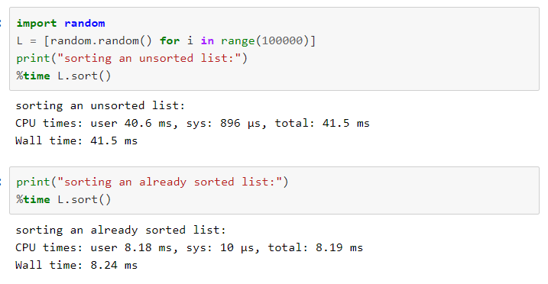
Timing

Slide 4
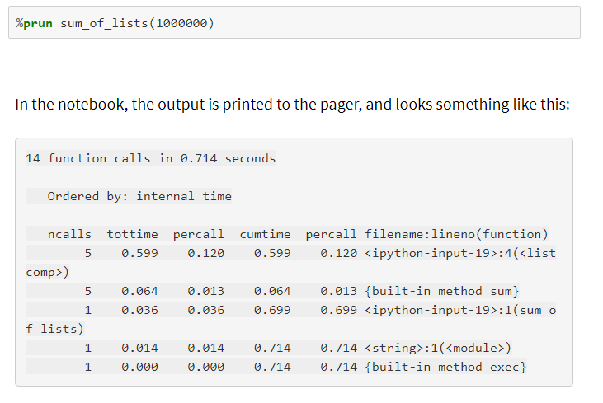
Profiling

Slide 5
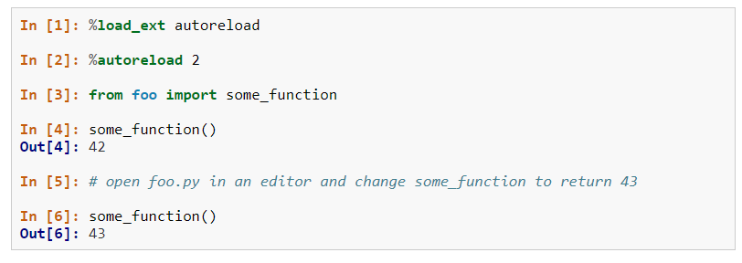
%Reload

Slide 6
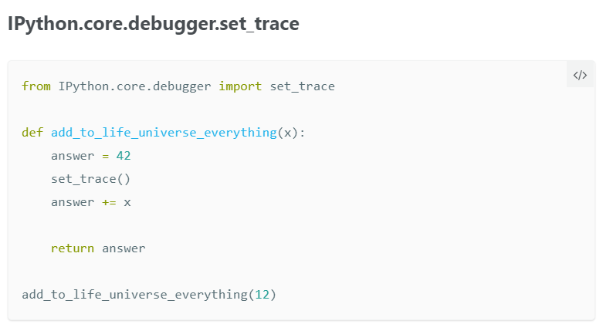
%debug

Slide 7
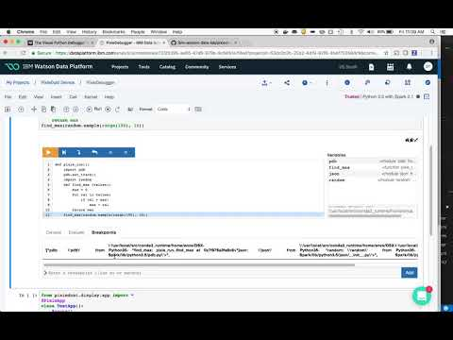
Visual Python Debugger

Slide 8
Jupyter extensions
1 - Collapsible headings
Very useful when dealing with large notebooks, collapsible headings allow you to collapse some parts of the notebooks.

Slide 9
2 - Notify
For long running task, the notify extension sends a notification when the notebook becomes idle.
Using notify

Slide 10
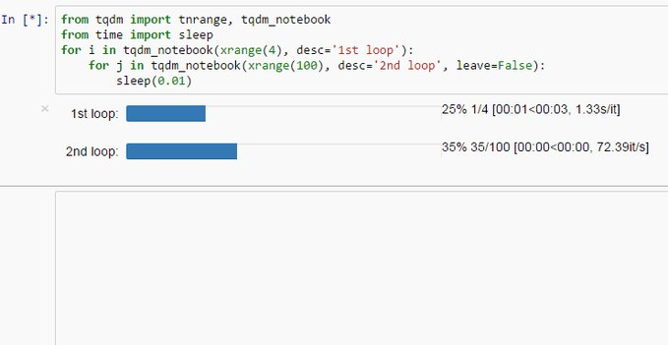
3 - Code folding
4 - tqdm_notebook

